Slide 1

HOSPITAL MANAGEMENT SYSTEM
HARCOURT BUTLER TECHNICAL UNIVERSITY KANPUR
TEAM: UNBEATABLE
TEAM MEMBERS
RIYA VERMA
MAYANK KHANNA
SATYENDRA SRIVASTAVA

Slide 2
INTRODUCTION ADVANTAGES OF HOSPITAL MANAGEMENT SYSTEM PROJECT DESCRIPTION: 1. AUTOMATIC REGISTRATION SYSTEM AT THE HOSPITAL 2.AUTOMATIC MEDICINE DISTRIBUTION SYSTEM 3. AUTOMATIC DOORS AND WINDOWS 4.AUTOMATIC SANITIZATION SYSTEM 5.REAL TOUCH ROBOTIC ARM FOR DOCTORS 6.AUTOMATE THE ELECTRICAL APPLIANCES CONCLUSION
PRESENTATION OUTLINE

Slide 3
INTRODUCTION
In the present time of increasing demands of technologies there is also
a need to upgrade our hospitals in terms of technology. As we have all seen that the past 1 year was full of challenges for our country due to COVID 19 crisis. Now we have to get ourselves ready for any such kind of pandemic situation.
HOSPITAL MANAGEMENT SYSTEM is a technical system in which we try to upgrade our hospitals with the latest technologies like there can be automatic registration of the patients after entering into the hospital with the help of Artificial Intelligence or IOT, there can also be a automatic medicine distribution, automatic hand sanitization and door system which is very important in this COVID situation and there can be many more such technologies which can help the doctors, patients by making there work easier.
So in the HOSPITAL MANAGEMENT SYSTEM we make use of Artificial Intelligence, Data Sciences, Internet of Things etc. to make the working system more effective.

Slide 4
ADVANTAGES OF HOSPITAL MANAGEMENT SYSTEM
The first and the most important advantage of Hospital Management System is that there will be proper a proper organization of the system.
In the present situation a person has to fill the registration form and only after that he/she gets the admission to the hospital and sometimes that person dies also but if the hospitals will have the Automatic Registration System then the responding time of doctors will decrease and patient life can be saved.
Sometimes in the hospitals due to a very long queue at the medicine counter serious patients do not get the medicines on time because there are only one or two person at the counter so to avoid this Automatic Medicine Distribution System is the best option to eradicate such kind of difficulties. This kind of system in each ward of the hospitals will be beneficial for those who want the medicines as early as possible.
We all have seen the COVID 19 situation few months ago and we all know that this disease spread through touch in the present situation we know that very few of hospitals have touch less door systems. So to avoid the spread 0f COVID 19 and other diseases which spread on touch Automatic Doors and Windows and Automatic Sanitization System can be the steps in the technical and hospital together can be the master stroke to eradicate COVID 19.

Slide 5
In many countries operations, surgeries and other treatments are done with the help of Robots. Real Touch Robotics Arm For Doctors will help doctors to treat patients better than the usual ways.
Automation of the Electrical Appliances like television, fans, air conditioners etc helps the patients in a better way. As when no one will be there with them so with the help of these automation they can operate the appliances easily.
Also the COVID spread can be reduced with the help of these automated appliances.
IF WE CAN REDUCE THE COST AND IMPROVE THE
TECHNOLOGY IN THE MEDICAL FIELD, WE CAN MORE
WIDELY ADDRESSES THE MEDICAL CONDITION AND
REDUCES THE HUMAN SUFFERING.

Slide 6
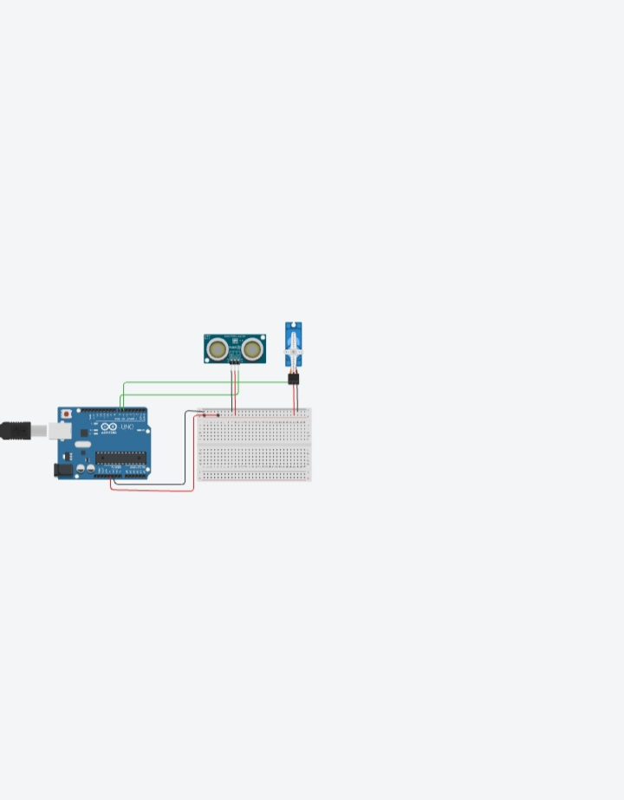
AUTOMATIC SANITIZATION SYSTEM
Now to improve the technology in the medical field and to fight with the diseases like COVID 19 and other spreading diseases automatic sanitizer dispenser is must used in the hospitals because there are chances in the manual sanitization system to get infected.

Slide 7
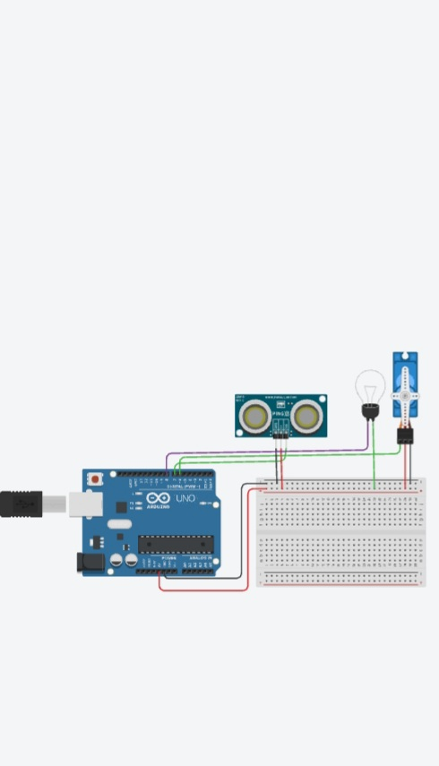
AUTOMATICS DOORS AND WINDOWS
We all have seen the COVID 19 situation few months ago and we all know that this disease spread through touch in the present situation we know that very few of hospitals have touch less door systems. So to avoid the spread 0f COVID 19 and other diseases which spread on touch Automatic Doors and Windows and Automatic Sanitization System can be the steps in the technical and hospital together can be the master stroke to eradicate COVID 19.

Slide 8
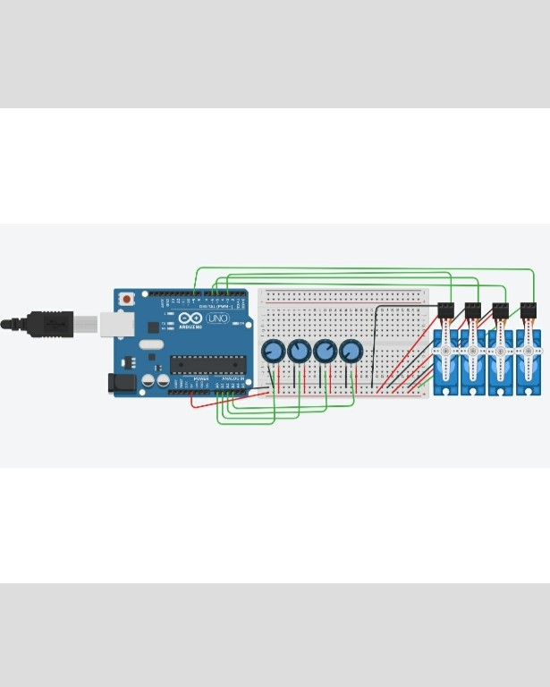
ROBOTIC ARMS FOR DOCTORS
In many countries operations, surgeries and other treatments are done with the help of Robots. Real Touch Robotics Arm For Doctors will help doctors to treat patients better than the usual ways.

Slide 9
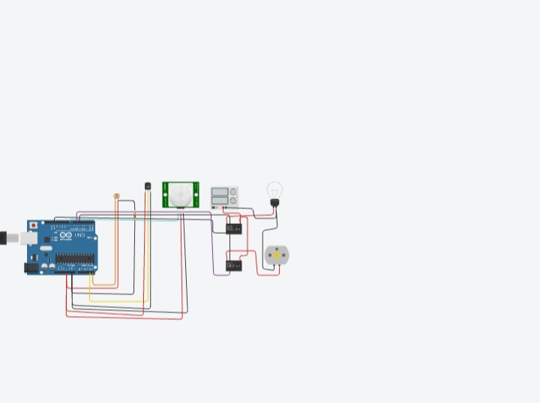
AUTOMATION OF ELECTRICAL APPLIANCES
Automation of the Electrical Appliances like television, fans, air conditioners etc helps the patients in a better way. As when no one will be there with them so with the help of these automation they can operate the appliances easily.
Also the COVID spread can be reduced with the help of these automated appliances.

Slide 10
CONCLUSION
Using automatic sanitizer dispenser we can prevent so many kind of infectious diseases.
Automatic robotic arm can also be lead to time saving and can save more life of patients.
Automatic gate opening system can also be useful to prevent direct contact

Slide 11
THANK YOU

